Slide 1
METAPHASE CONTROLLER WITH BASLER CAMERA

Slide 2
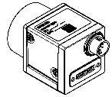
ACE CAMERA INPUT TRANSISTOR
acA camera input is PNP transistor and output is NPN

Slide 3
ULC-2 TRIGGERING CONNECTION

Slide 4
HARDWARE CONNECTION - NPN
Metaphase ULC-2
+24VDC
GND
GND
GPIO / Opto-isolated
Basler Camera

Slide 5
THANK YOU
sales@sodavision.com
www.sodavision.com

